Slide 1
Lock Guard
08/06/2021

Slide 2
General Information
Can use instead of locking and unlocking → unlocks at the point where the scope of the thread/object is over using destructor
Functions as a lightweight wrapper for owning mutex on a scoped basis
When you create lock_guard, the mutex is locked
YOU CANNOT explicitly unlock the lock guard

Slide 3
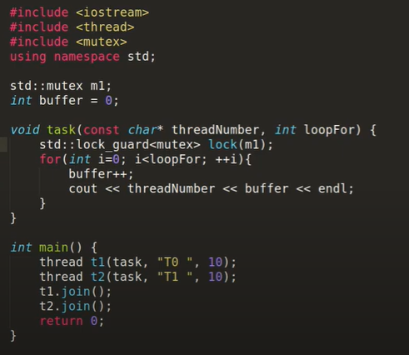
Syntax Example

